Slide 1
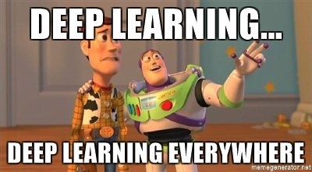
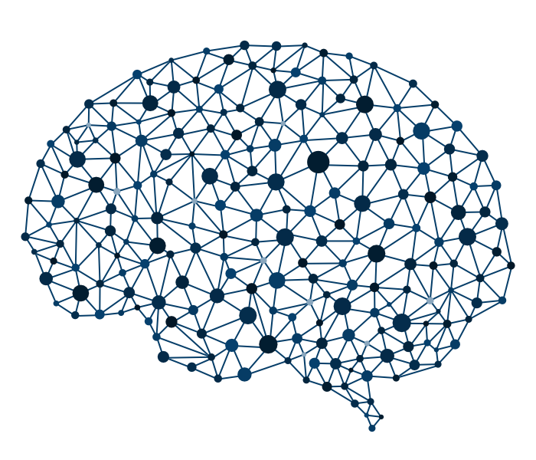
Deeeeep Learning
From yours truly: David Grossman
With help from Deep Learning powerpoints everywhere.

Slide 2
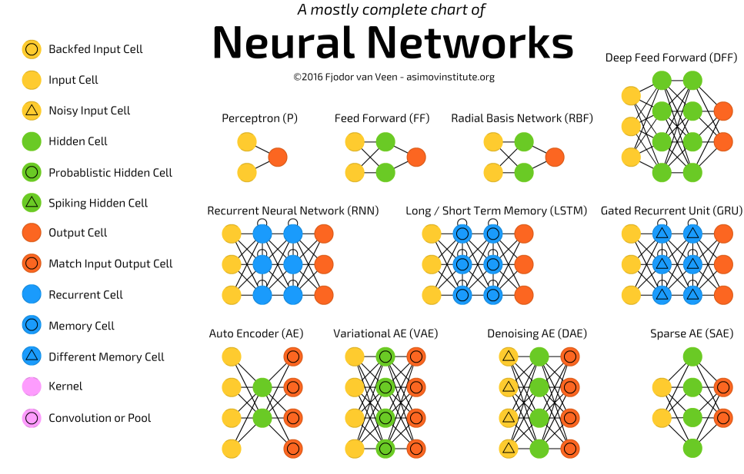


Tip
Don’t get overwhelmed

Slide 3
1. Intro
The main topics for today:
What is a Neural Network (NN) and Deep Learning?
How to train a neural network
Neural Networks in the real world: Convolutional Neural Networks

Slide 4

Neural Networks and Deep Learning 101.
1. Neural Networks and Deep Learning

Slide 5
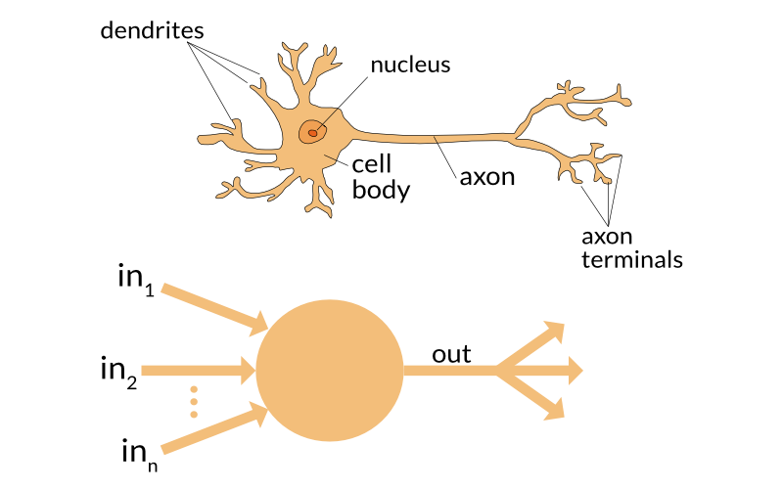
Inspiration
1. Neural Networks and Deep Learning

Slide 6
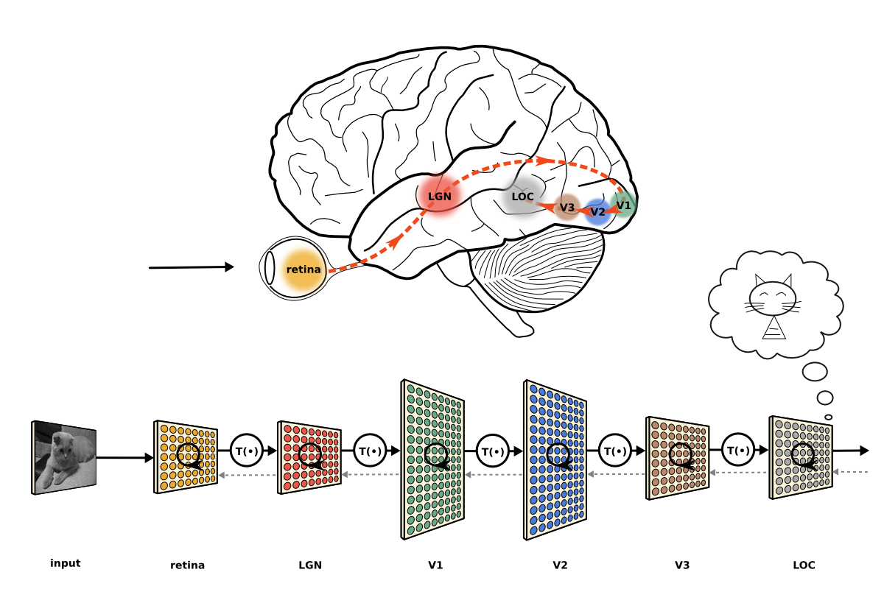

Inspiration
1. Neural Networks and Deep Learning
The brain’s neurons are organized in a hierarchical nature.
One cortex of neurons passes information up the hierarchy….we think.

Slide 7
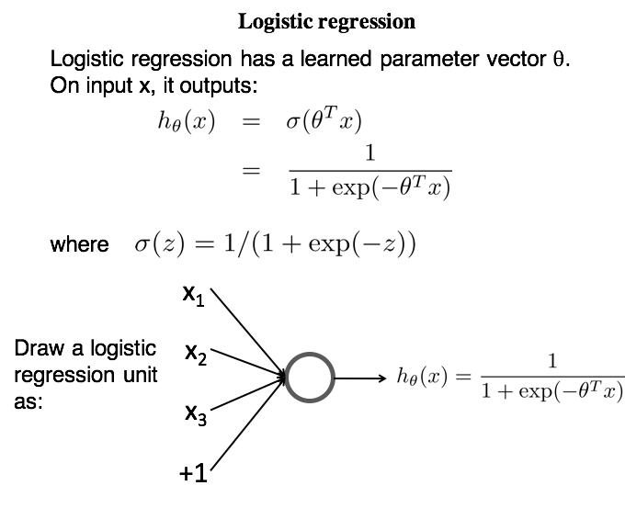
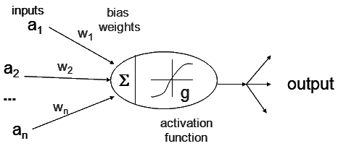
Some background
1. Neural Networks and Deep Learning
Our model Neuron

Slide 8
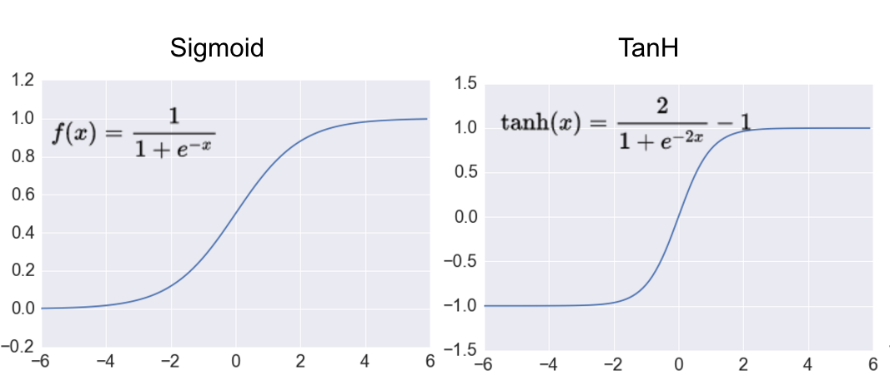
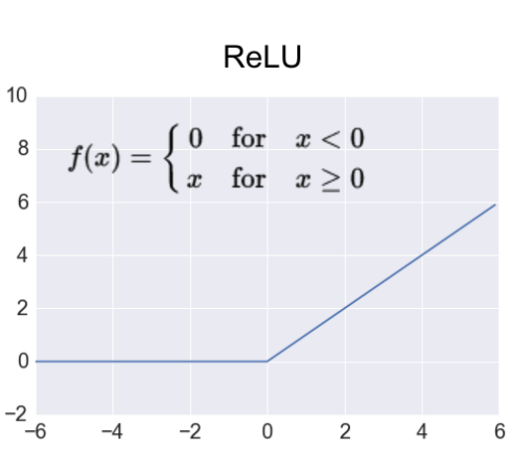
Activation Functions
1. Neural Networks and Deep Learning
Our model Neuron

Slide 9
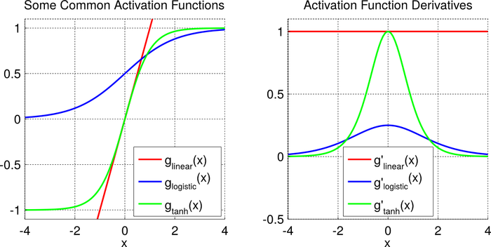
Activation Function
Non-linear...ish
1. Neural Networks and Deep Learning
Our model Neuron

Slide 10
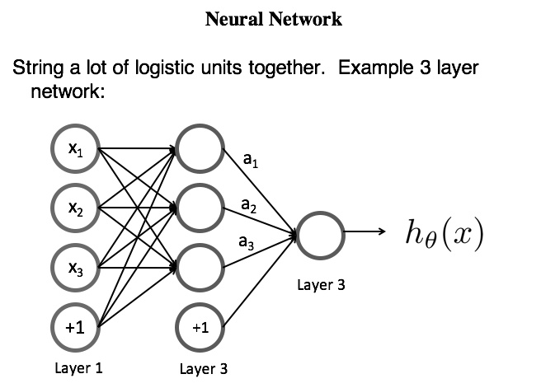
A simple neural network
1. Neural Networks and Deep Learning

Slide 11
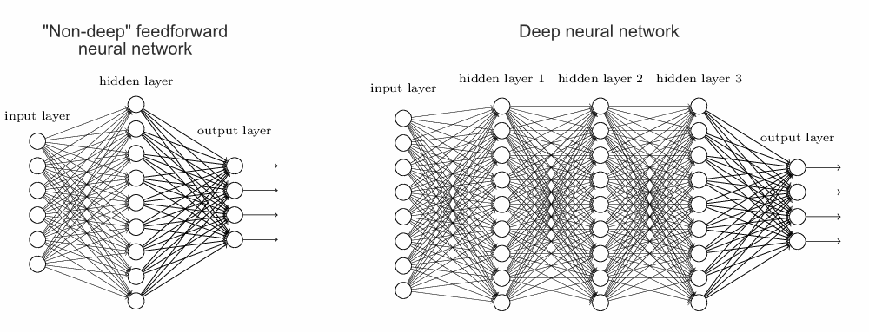
A Deep Neural Network
1. Neural Networks and Deep Learning

Slide 12
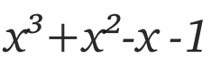
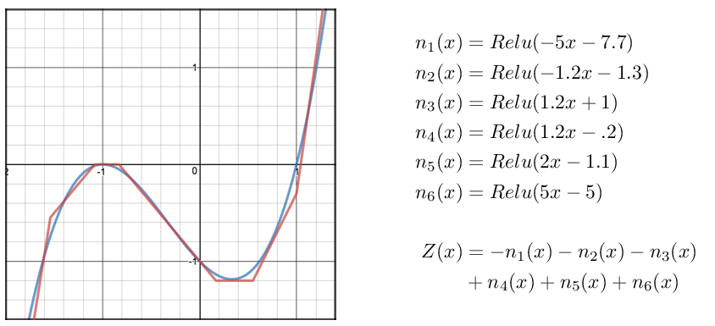
Why go deep?
Theoretically: Universal function approximator
1. Neural Networks and Deep Learning
medium.com/towards-data-science

Slide 13
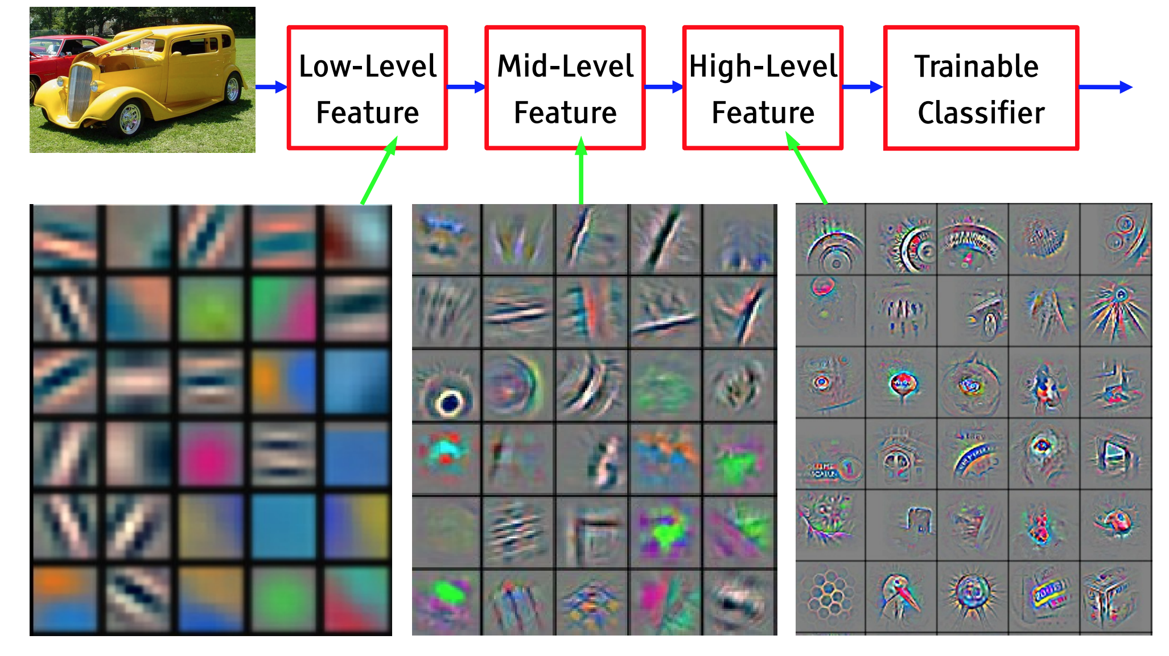
Why go deep?
Conceptually: Learning new features
1. Neural Networks and Deep Learning

Slide 14

Training a deep neural network and hyperp-
arameters.
2. Training neural networks and hyperparameters

Slide 15
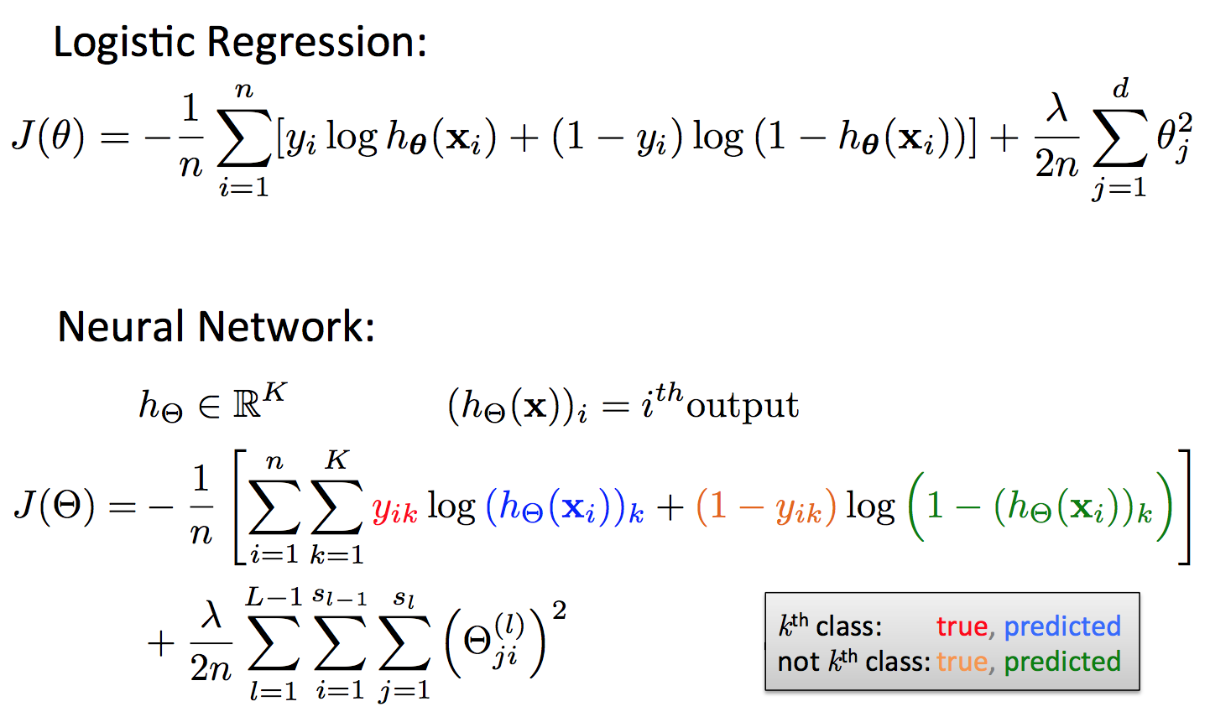
Cost Function
2. Training neural networks and hyperparameters

Slide 16
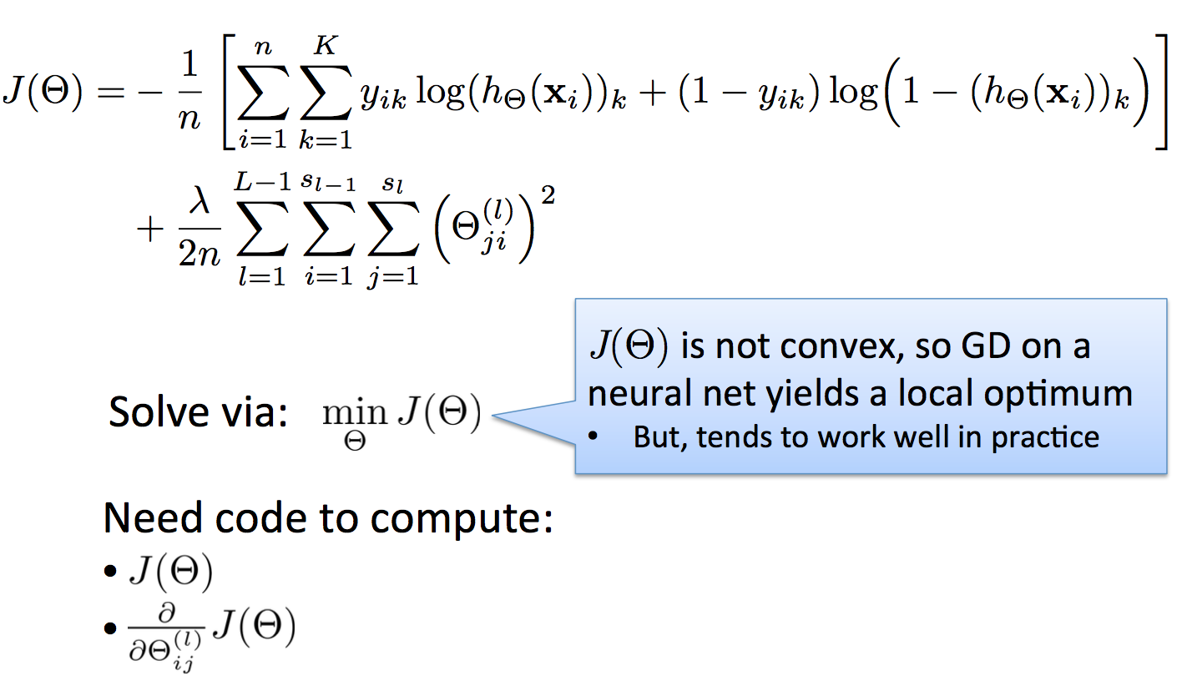
Backpropagation
2. Training neural networks and hyperparameters
Tip
The regularizer term is present to reduce bias.
Think about it as not over depending on a certain feature by making it costly to weight it heavily.

Slide 17
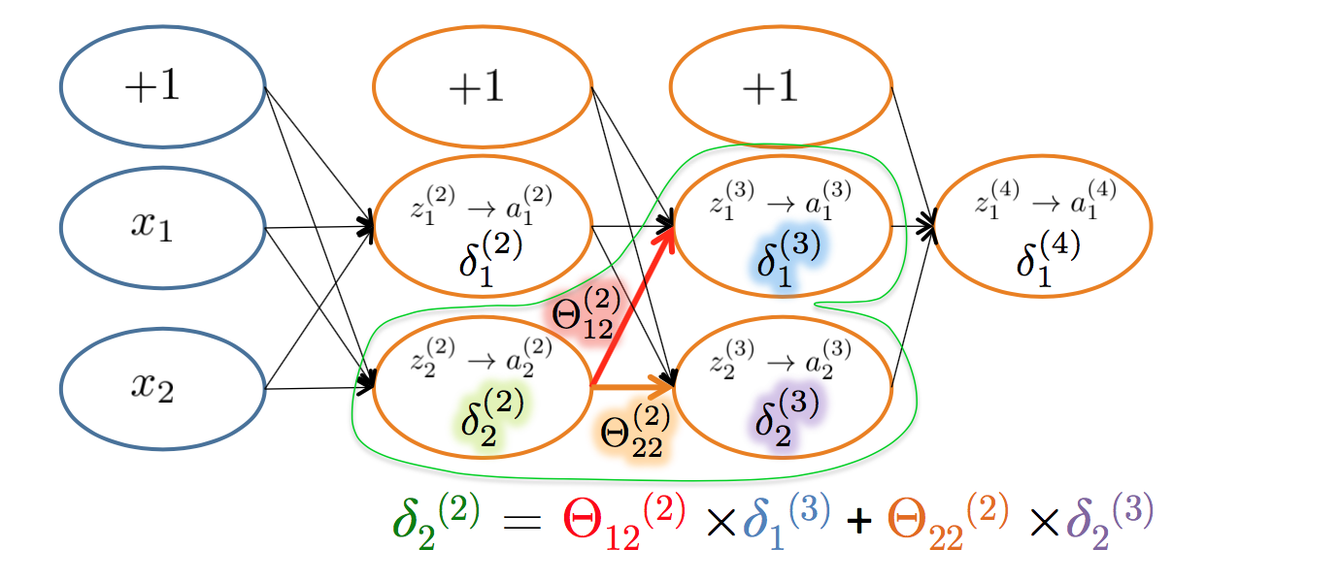
Backpropagation intuition
2. Training neural networks and hyperparameters
Each hidden node j is “responsible” for some fraction of the error δ_{j}(l) in each of the output nodes to which it connects
δ_{j}(l) is divided according to the strength of the connection between hidden node and the output node
Then, the “blame” is propagated back to provide the error values for the hidden layer

Slide 18
Backpropagation
2. Training neural networks and hyperparameters
“Backprop is the cockroach of machine learning. It’s ugly, and annoying, but you just can’t get rid of it.” -Geoff Hinton

Slide 19
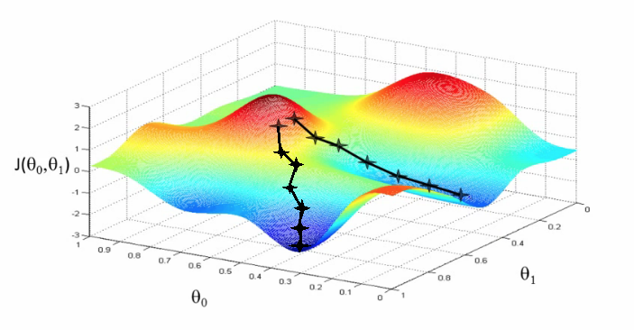
Gradient Descent
2. Training neural networks and hyperparameters

Slide 20
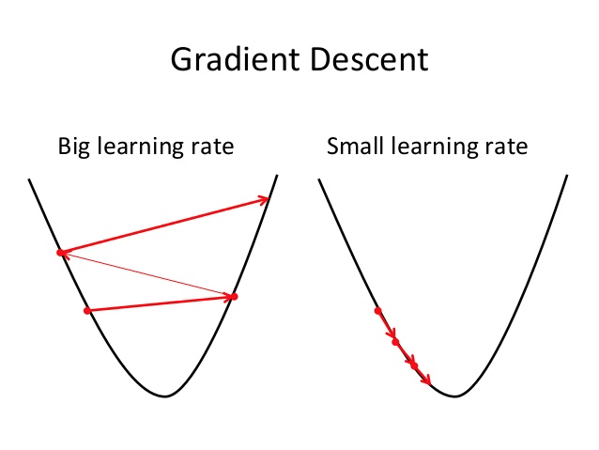
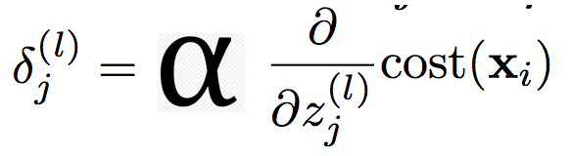
Gradient Descent and Learning Rates
2. Training neural networks and hyperparameters

Slide 21
Training a Neural Network
2. Training neural networks and hyperparameters
Randomly initialize weights
Implement forward propagation to get h_{Θ}(x_{i}) for any instance x
Implement code to compute cost function J(Θ)
Implement backprop to compute partial derivatives
Use gradient checking to compare computed using backpropagation vs. the numerical gradient estimate.
Then, disable gradient checking code
Use gradient descent with backprop to fit the network

Slide 22
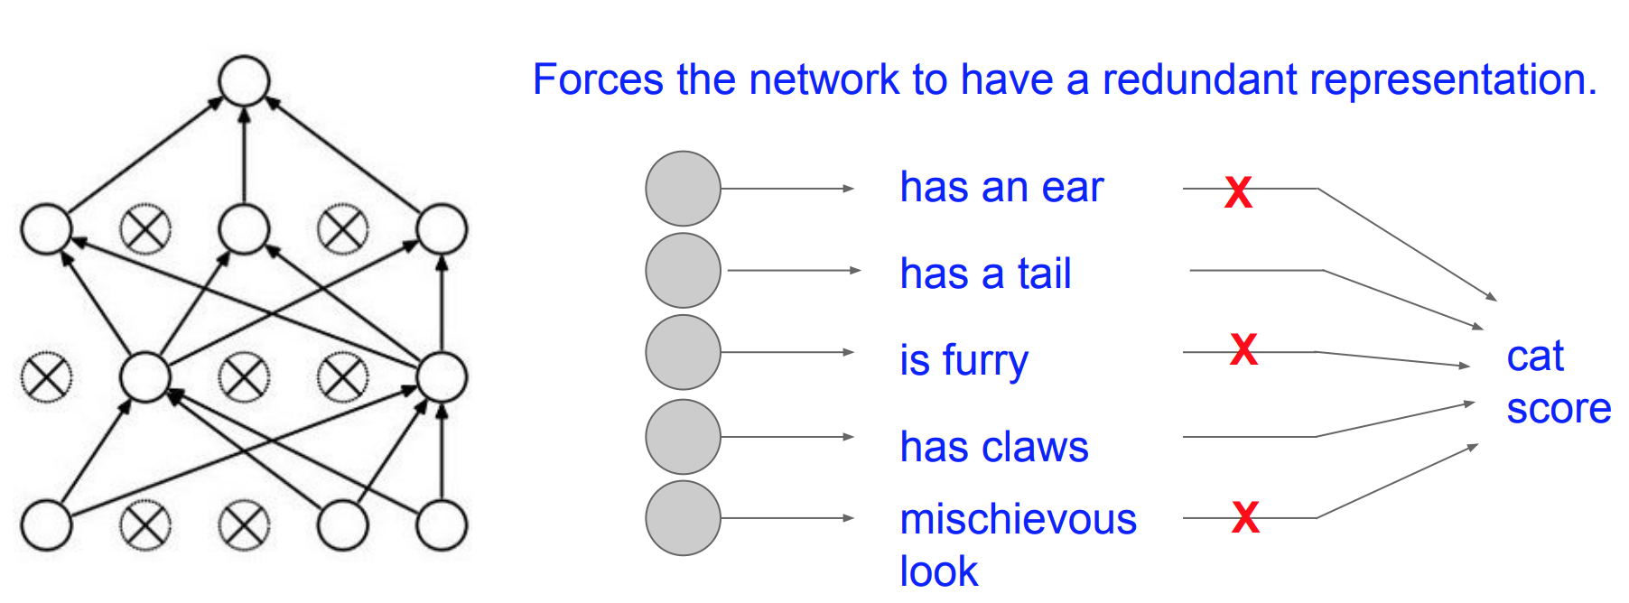
An ensembling trick: Dropout
2. Training neural networks and hyperparameters

Slide 23

Convolutional
Neural Networks.
Thank you Andrej Karpathy
3. Convolutional Neural Networks

Slide 24
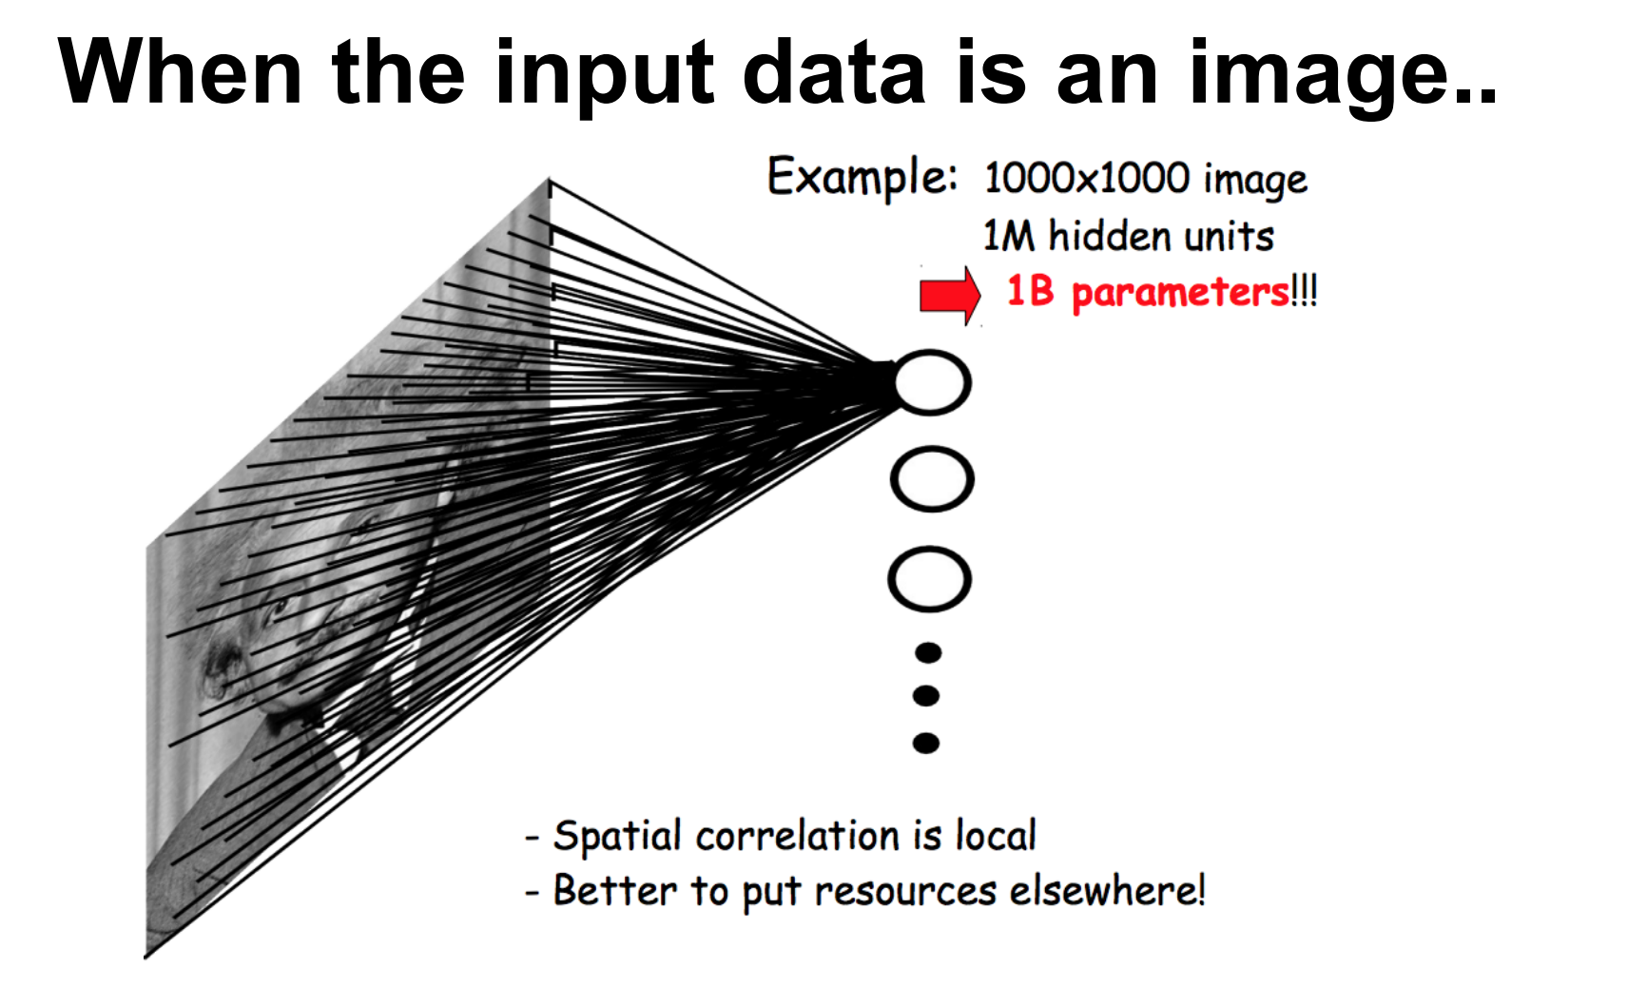
Motivation
3. Convolutional Neural Networks

Slide 25
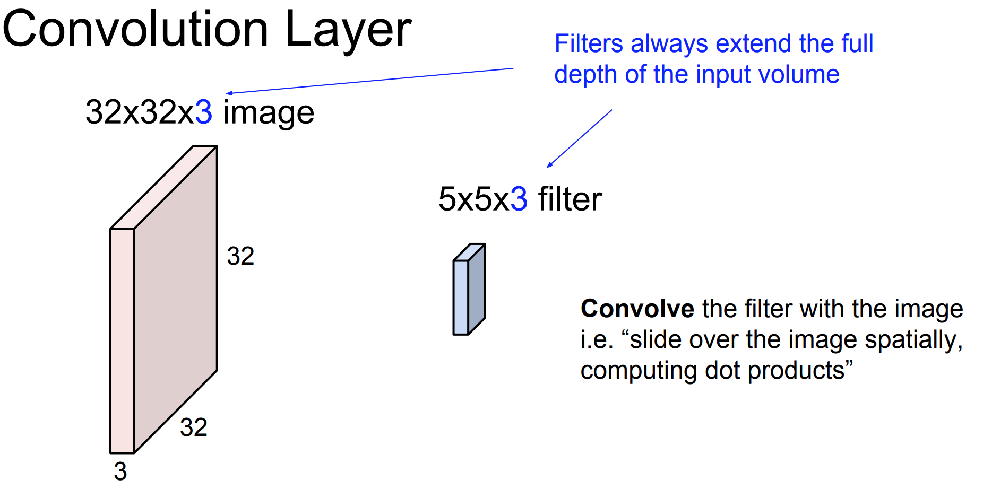
Convolution “Kernels”
3. Convolutional Neural Networks

Slide 26
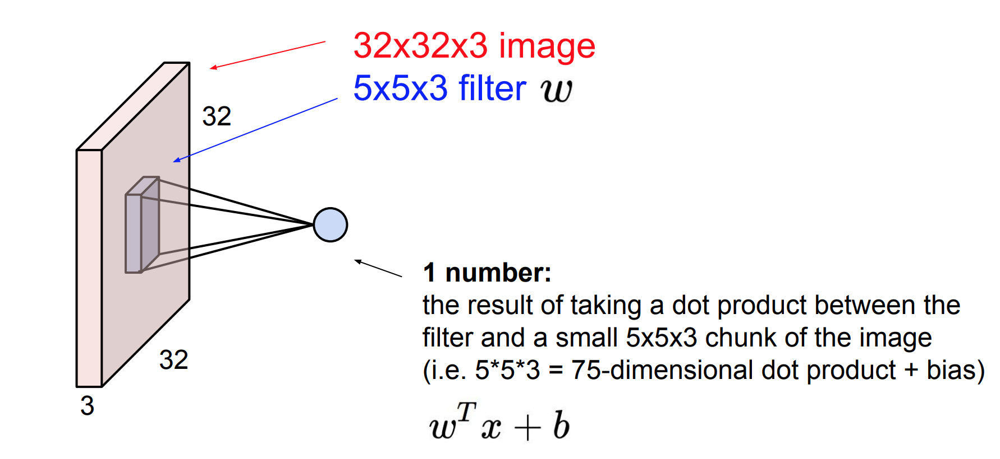
Convolution “Kernels”
3. Convolutional Neural Networks

Slide 27
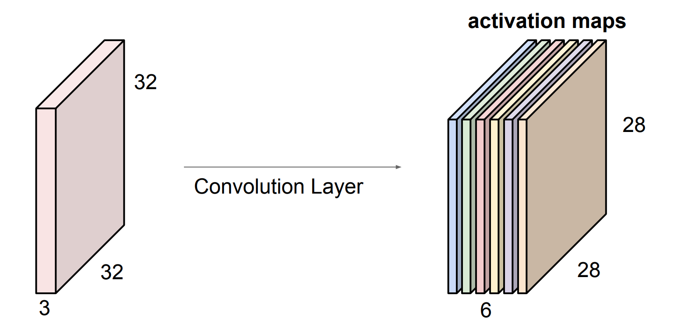
Convolutional Kernels
Each Kernel represents some “feature”
3. Convolutional Neural Networks

Slide 28
Convolutional Kernels
Each Kernel represents some “feature”
3. Convolutional Neural Networks

Slide 29
Convolutional Kernels
Each Kernel represents some “feature”
3. Convolutional Neural Networks

Slide 30
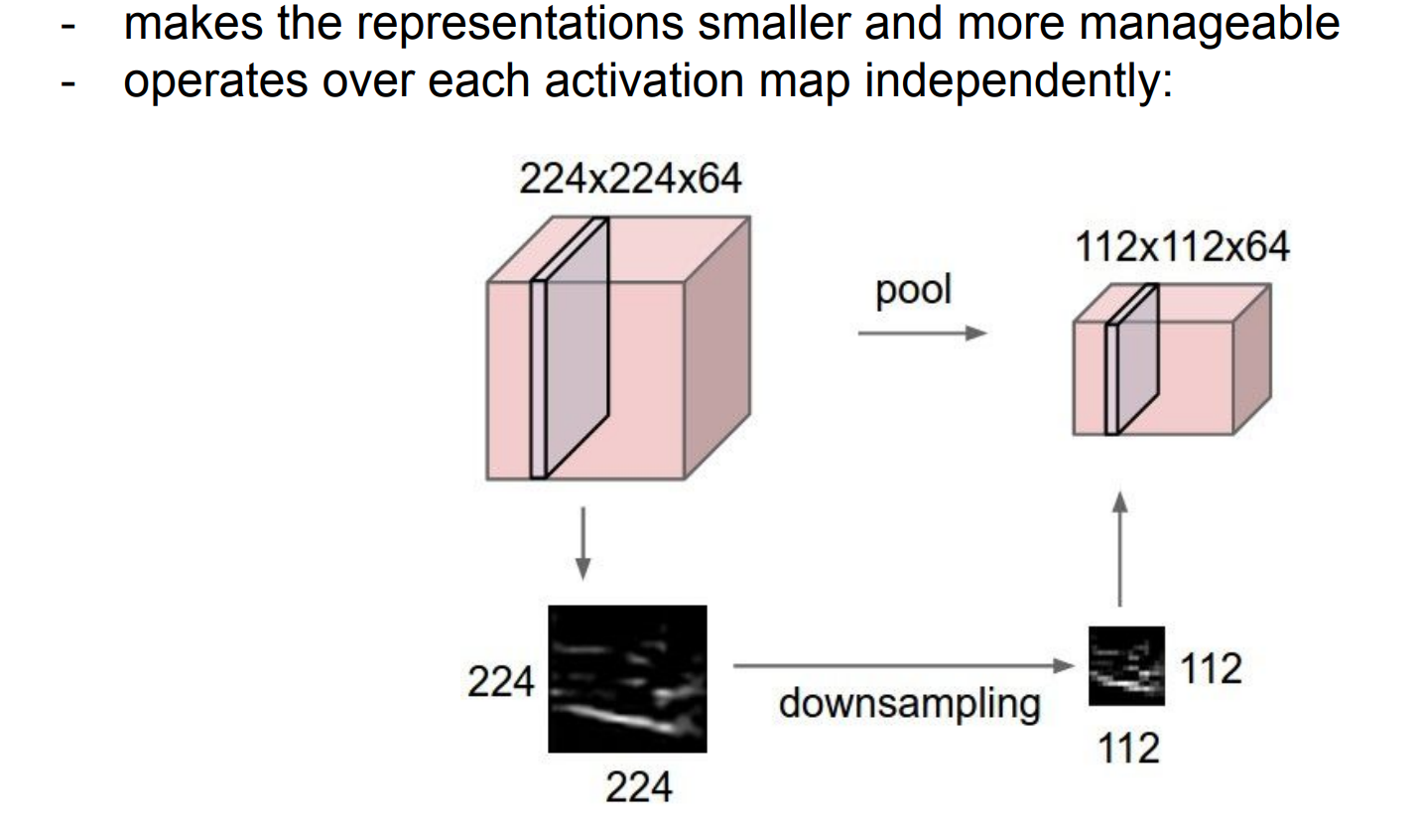
Pooling Layers
3. Convolutional Neural Networks

Slide 31
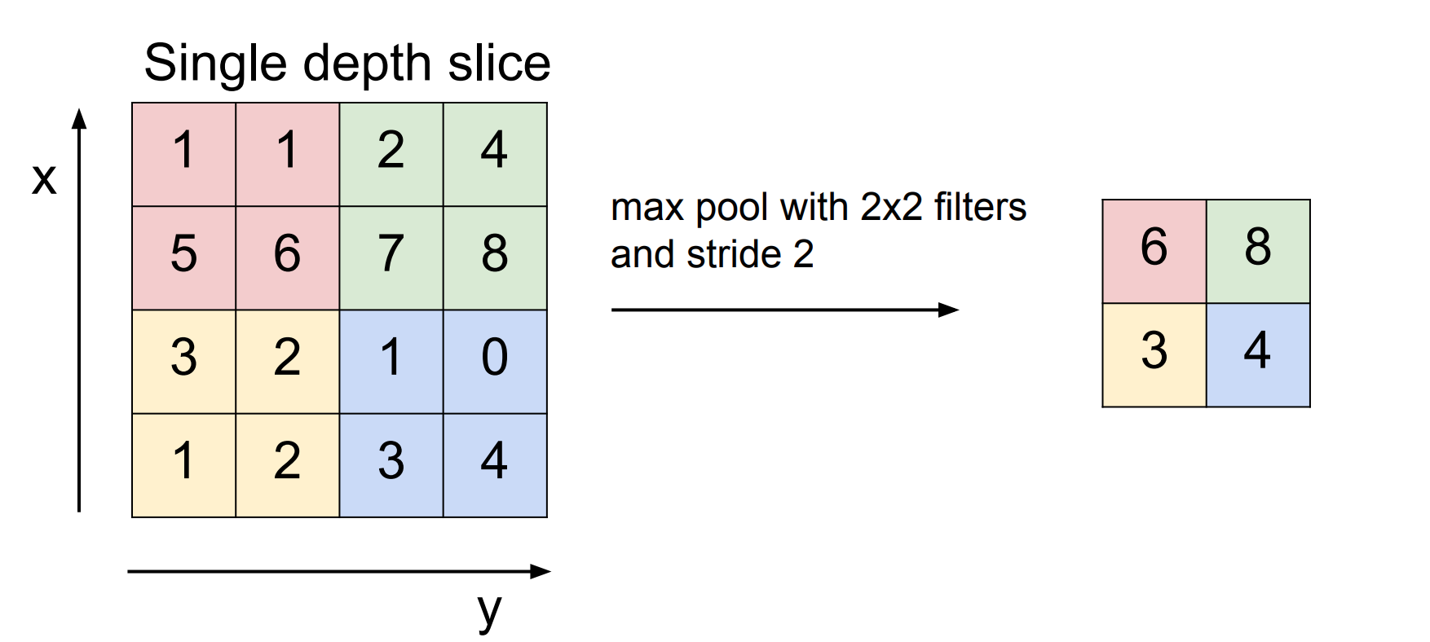
Pooling Layers
3. Convolutional Neural Networks

Slide 32

A “simple” Convolutional NN
3. Convolutional Neural Networks

Slide 33
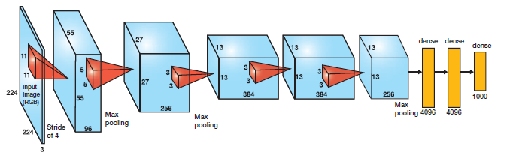
AlexNet
3. Convolutional Neural Networks

Slide 34
HyperParameters!!
3. Convolutional Neural Networks
Stride
Padding
Kernel Size
Pooling Kernel Size
Max, average pooling
Normalization

Slide 35
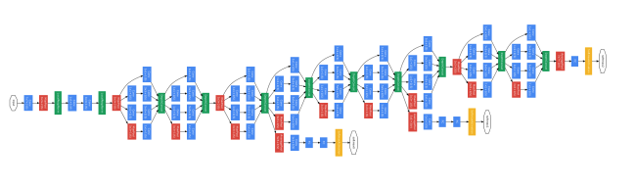
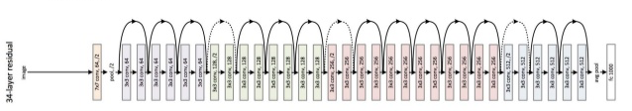
Just the tip of the iceberg
3. Convolutional Neural Networks

Slide 36
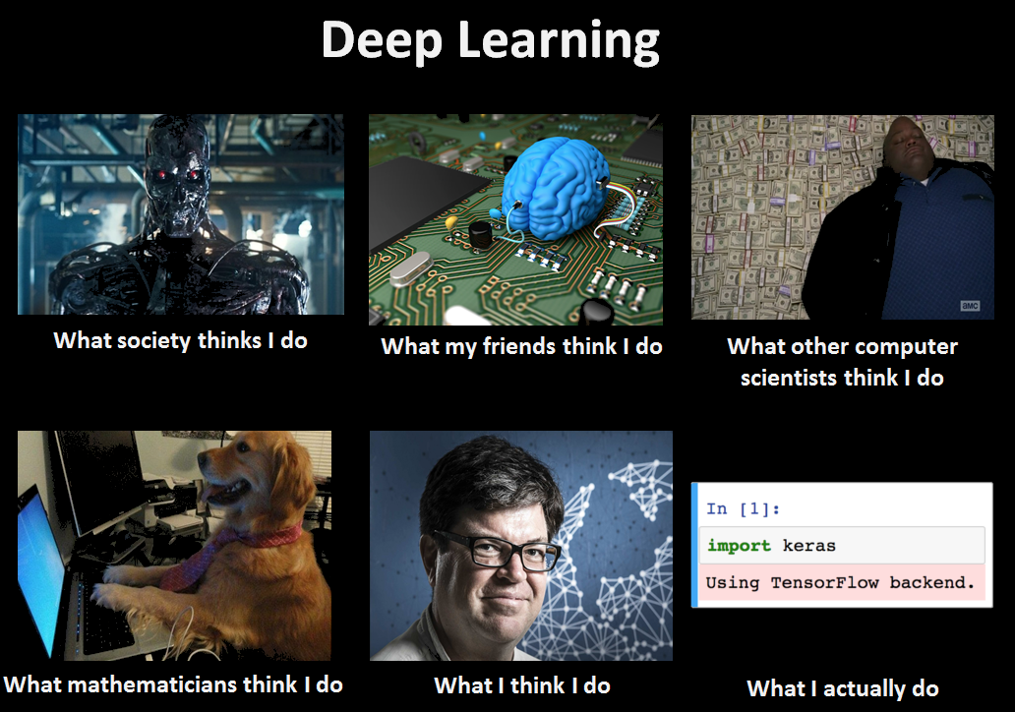

Slide 37
Good luck!
Hope you survive the AI revolution.
If you do survive, please reach out if you have any questions: davidgrossman@miami.edu

